Slide 1
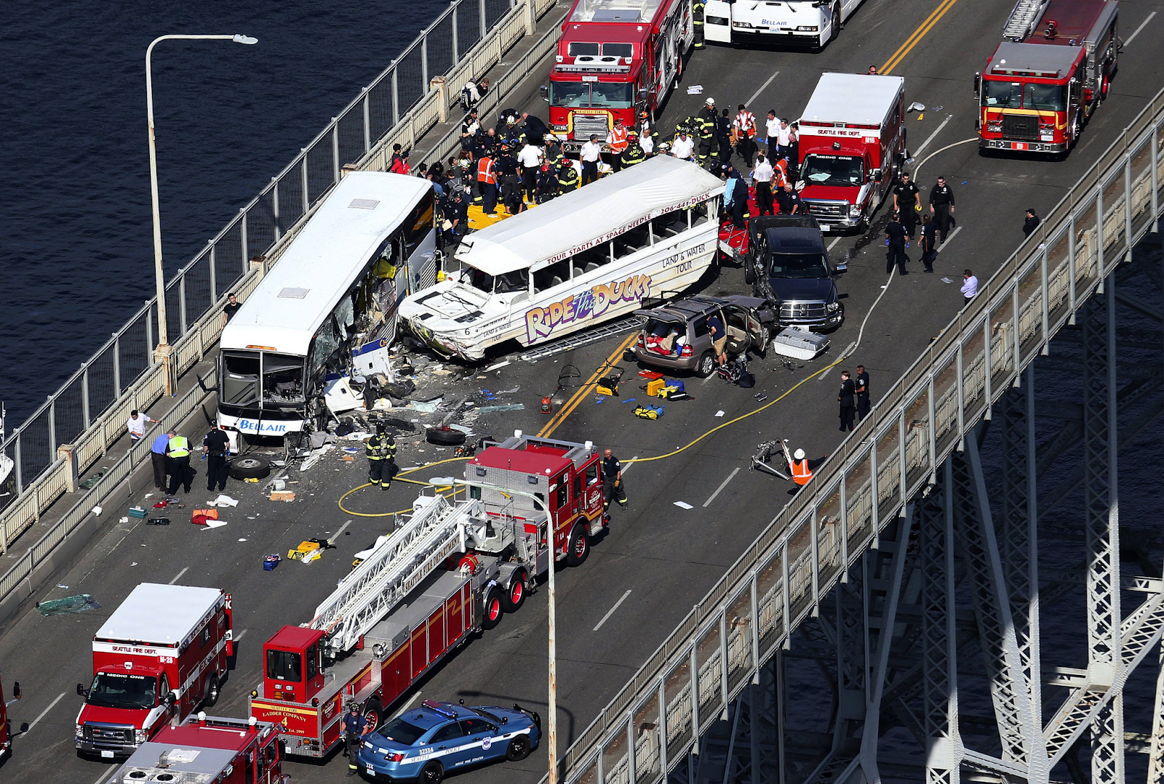
SEATTLE ROAD Accidents Harshit Jain
This Photo by Unknown Author is licensed under CC BY-SA

Slide 2
CONTENTS
THE PROBLEM
DATA CLEANING
DATA ANALYSIS
PREDICTIVE MODELING

Slide 3
THE PROBLEM
Seattle is the largest city in Washington
Road accidents fairly high relative to Washington
Abusing drugs and alcohol or driving at very high speed are the main causes of occurring accidents that can be prevented by enacting harsher regulations.

Slide 4
THE DATA
Seattle GeoData from 2004 - 2020
37 attributes
-Missing values/ incomplete data

Slide 5
CLEANING
- Create separate date and time columns, convert to string format
- Extract day, month and hour and put in integer format
-One hot encoding for predictive modelling

Slide 6
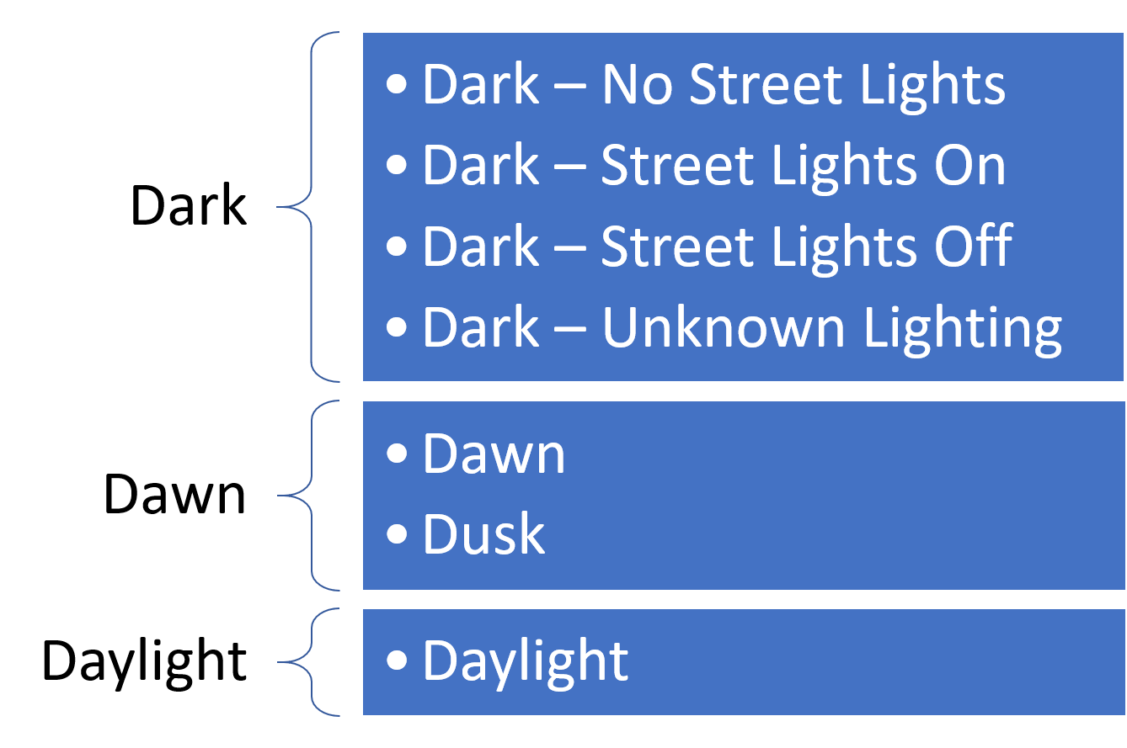
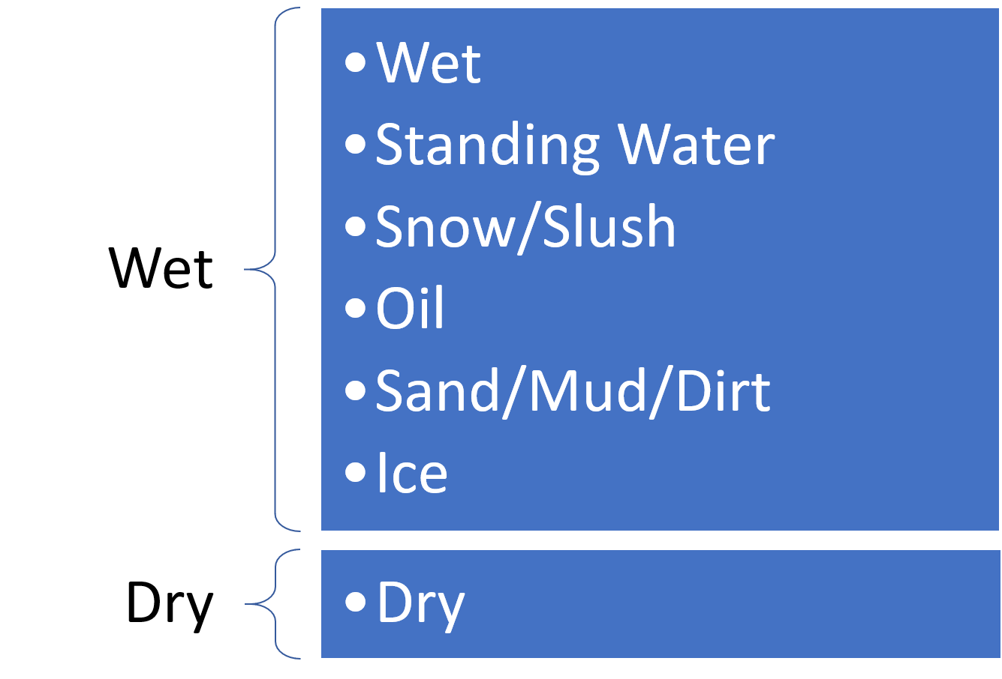
ONE HOT ENCODING

Slide 7
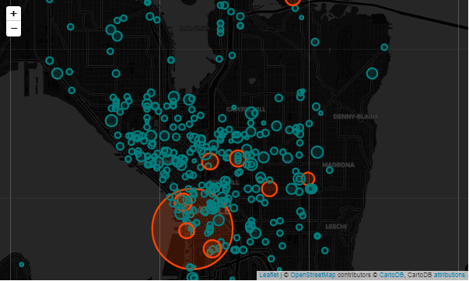
ANALYSIS
Folium map showing the first 1000 datapoints
Accidents fairly spread out with a cluster forming centrally

Slide 8
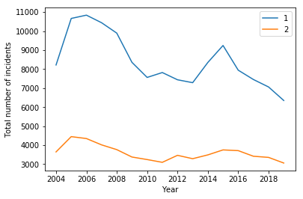
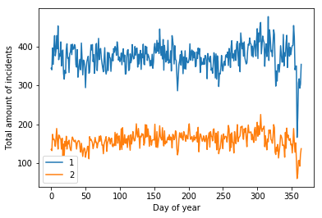
ANALYSIS DATE

Slide 9
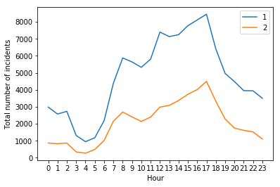
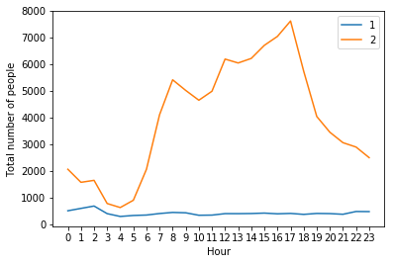
ANALYSIS TIME

Slide 10
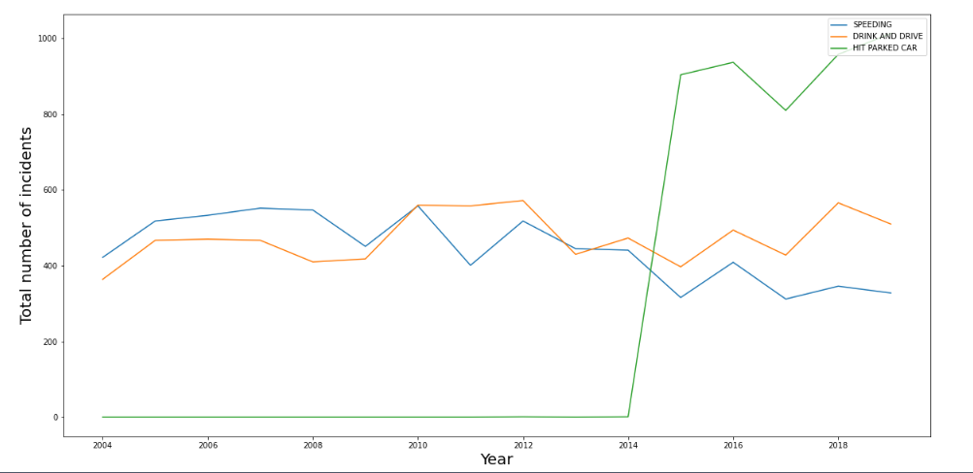
Analysis
Abusing Drugs
and Drink
Or
Driving at
very high Speed

Slide 11
PREDICTIVE MODELLING
Logistic Regression
SGD Classifier
K nearest neighbours
Random Forest

Slide 12
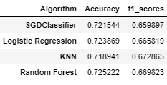
RESULTS
F1-score more accurate

Slide 13
CONCLUSION
Accuracy fairly even across all models
Random Forest most accurate
Logistic Regression is best for the prediction modelling data as it require less time and less computation as compare to other models.
Analyse location

Slide 14


